Slide 1

Leading the Way:
Empowering Teachers During an Adoption
2.7.25
Becky Curtright & Carrie Hair

Slide 2
Today's Learning Intention
We will be learning about the critical role leadership has in the successful adoption of new instructional materials
Success Criteria
Begin to identify and develop your role as the educational leader to effectively guide and empower teachers throughout the implementation process.

Slide 3

Implementing New Curriculum
Skim and Scan.
  Intro: pgs 1-3
  Changing Mindsets: pgs 4-6
Select 2-3 sentences/phrases that resonate with you.
Share sentence/phrases with your group

Slide 4
Implementing a New Curriculum
When you’ve implemented new materials in the past,
What steps have made it successful?
OR
What are some barriers you’ve encountered?
AND
What do you see your role in the implementation process as the educational leader at your site?

Slide 5
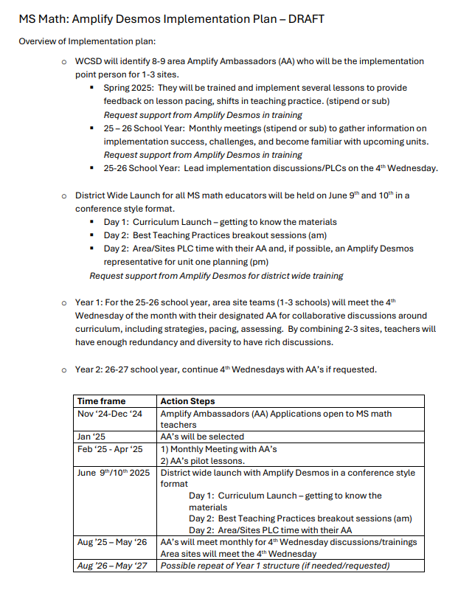
Revisit Amplify Desmos Math
Implementation Plan
Start Strong & Monthly Support
3 Main Components
Area Amplify Ambassadors.
Launch 6/9-6/10 professional learning for teachers
Year-long implementation support on 4th Wednesdays.
How is this plan supported by the article?
What other supports would you like to see in the implementation plan?

Slide 6
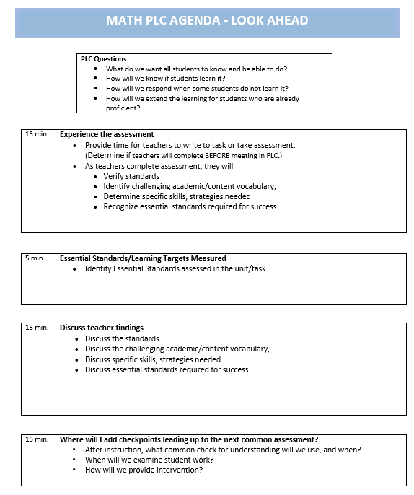
Our Vision: Look Ahead Protocol:
How do you see this process fitting within Teacher Clarity?
Learning Progressions?
Learning Intentions?
Success Criteria?

Slide 7
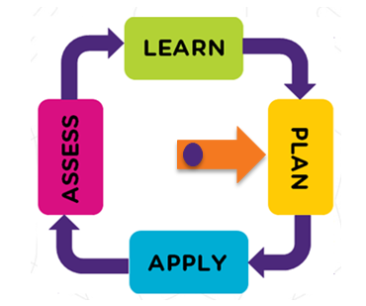
How will the 4th Wednesday's support your site's implementation process?

Slide 8

Where are you at in leading your teachers?
Reflect and
Process Time
What are your next steps as a leader?
What supports do you need?

Slide 9


Please feel free to email us if we didn't get to your question(s), or you have another one.
Becky Curtright, Assessment, rcurtright@washoeschools.net
Carrie Hair, C & I, chair@washoeschools.net

